Slide 1
Chapter 10
Functional Dependencies and Normalization for Relational Databases
Copyright © 2007 Pearson Education, Inc. Publishing as Pearson Addison-Wesley

Slide 2
Chapter Outline
1 Informal Design Guidelines for Relational Databases
  1.1Semantics of the Relation Attributes
  1.2 Redundant Information in Tuples and Update Anomalies
  1.3 Null Values in Tuples
  1.4 Spurious Tuples
2 Functional Dependencies (FDs)
  2.1 Definition of FD
  2.2 Inference Rules for FDs
  2.3 Equivalence of Sets of FDs
  2.4 Minimal Sets of FDs
Slide 10- <number>

Slide 3
Chapter Outline
3 Normal Forms Based on Primary Keys
  3.1 Normalization of Relations
  3.2 Practical Use of Normal Forms
  3.3 Definitions of Keys and Attributes Participating in Keys
  3.4 First Normal Form
  3.5 Second Normal Form
  3.6 Third Normal Form
4 General Normal Form Definitions (For Multiple Keys)
5 BCNF (Boyce-Codd Normal Form)
Slide 10- <number>

Slide 4
1 Informal Design Guidelines for Relational Databases (1)
What is relational database design?
  The grouping of attributes to form "good" relation schemas
Two levels of relation schemas
  The logical "user view" level
  The storage "base relation" level
Design is concerned mainly with base relations
What are the criteria for "good" base relations?
Slide 10- <number>

Slide 5
Informal Design Guidelines for Relational Databases (2)
We first discuss informal guidelines for good relational design
Then we discuss formal concepts of functional dependencies and normal forms
  A normal form is a state of a relation that results from applying simple rules regarding functional dependencies (or relationships between attributes) to that relation.
  - 1NF (First Normal Form)
  - 2NF (Second Normal Form)
  - 3NF (Third Normal Form)
  - BCNF (Boyce-Codd Normal Form)
Slide 10- <number>

Slide 6
Normalization
Normalization is the process of successively reducing relations with anomalies to produce smaller, well-structured relations.
Goals are:
  Minimize data redundancy, thereby avoiding anomalies and conserving storage space
  Simplify the enforcement of referential integrity constraints
  Make it easier to maintain data (insert, update and delete)
  Provide a better design that is an improved representation of the real world and a stronger basis for future growth
  Hoffer et.al. “Modern Database Management”, 8th Edition,2007
Slide 10- <number>

Slide 7
1.1 Semantics of the Relation Attributes
GUIDELINE 1: Informally, each tuple in a relation should represent one entity or relationship instance. (Applies to individual relations and their attributes).
  Attributes of different entities (EMPLOYEEs, DEPARTMENTs, PROJECTs) should not be mixed in the same relation
  Only foreign keys should be used to refer to other entities
  Entity and relationship attributes should be kept apart as much as possible.
Bottom Line: Design a schema that can be explained easily relation by relation. The semantics of attributes should be easy to interpret.
Slide 10- <number>

Slide 8
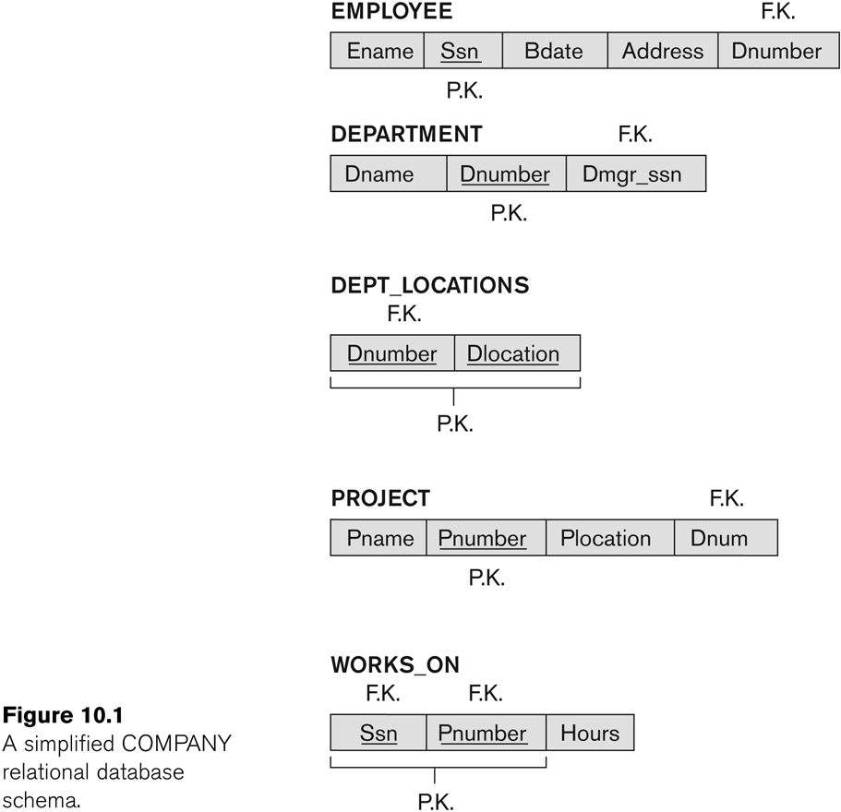
Slide 10- <number>

Slide 9
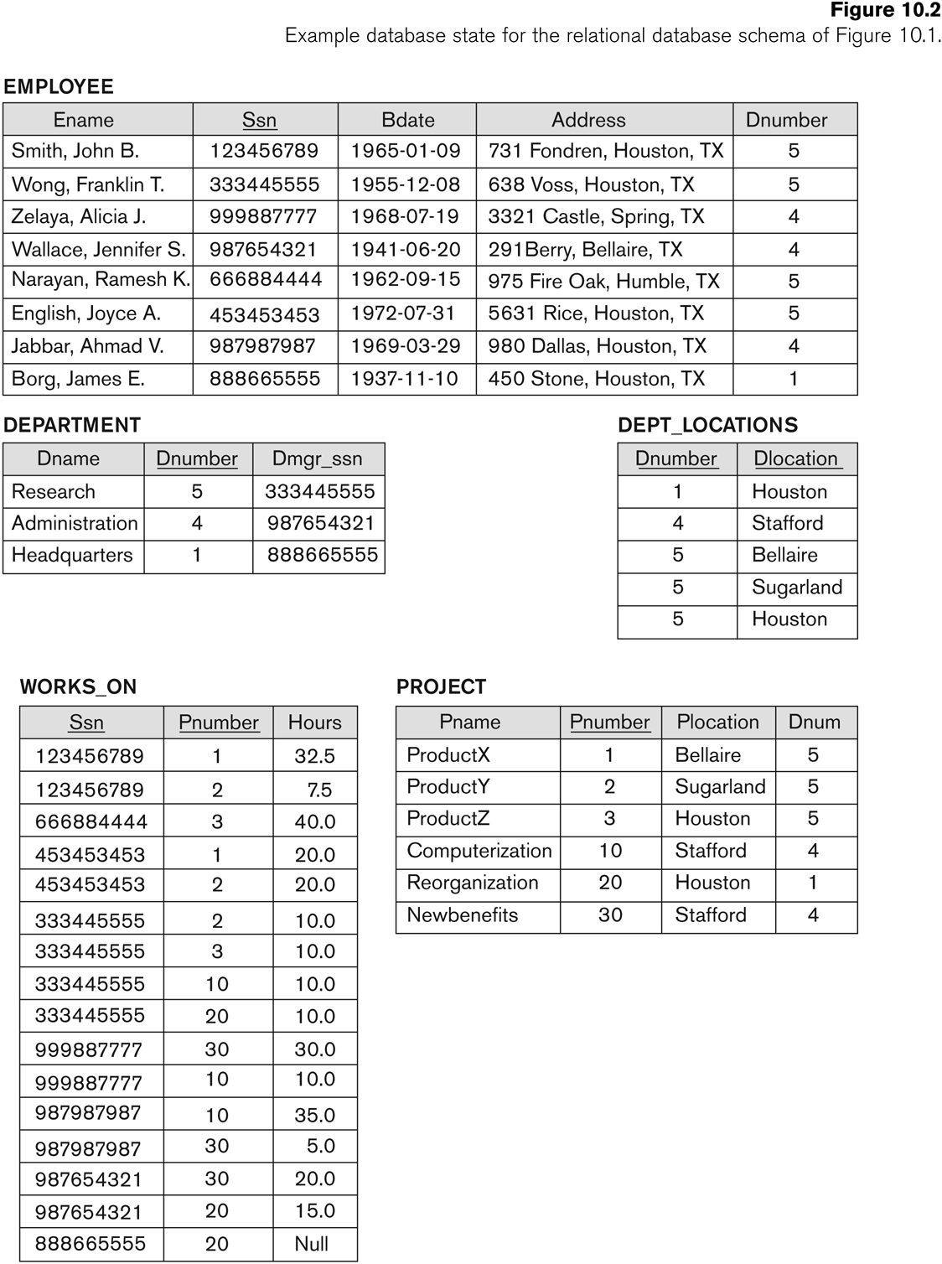
Slide 10- <number>

Slide 10
1.2 Redundant Information in Tuples and Update Anomalies
Information is stored redundantly
  Wastes storage
  Causes problems with update anomalies
    Insertion anomalies
    Deletion anomalies
    Modification anomalies
Slide 10- <number>

Slide 11
EXAMPLE OF AN UPDATE ANOMALY
Consider the relation:
  EMP_PROJ(Emp#, Proj#, Ename, Pname, No_hours)
Update Anomaly:
  Suppose there are 100 employees working on project P1.
  Changing the name of project number P1 from “Billing” to “Customer-Accounting” may cause this update to be made for all 100 employees working on project P1.
Slide 10- <number>

Slide 12
EXAMPLE OF AN INSERT ANOMALY
Consider the relation:
  EMP_PROJ(Emp#, Proj#, Ename, Pname, No_hours)
Insert Anomaly:
  Cannot insert a project unless an employee is assigned to it.
Conversely
  Cannot insert an employee unless he/she is assigned to a project.
Slide 10- <number>

Slide 13
EXAMPLE OF AN DELETE ANOMALY
Consider the relation:
  EMP_PROJ(Emp#, Proj#, Ename, Pname, No_hours)
Delete Anomaly:
  When a project is deleted, it will result in deleting all the employees who work on that project.
  Alternately, if an employee is the sole employee on a project, deleting that employee would result in deleting the corresponding project.
Slide 10- <number>

Slide 14
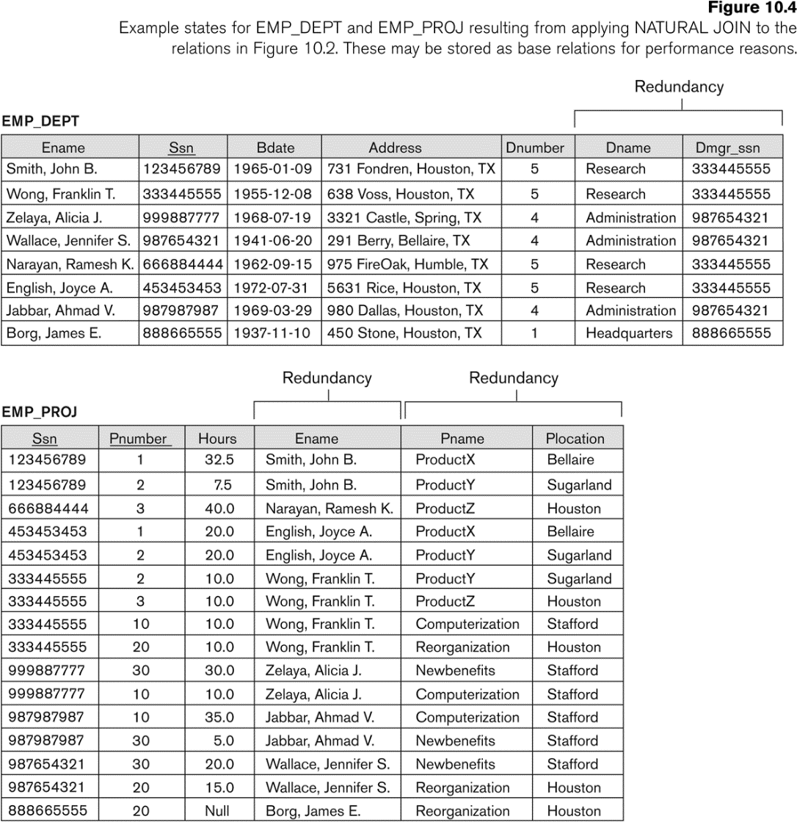
Base Relations EMP_DEPT and EMP_PROJ formed after a Natural Join : with redundant information
Slide 10- <number>

Slide 15
Guideline to Redundant Information in Tuples and Update Anomalies
GUIDELINE 2:
  Design a schema that does not suffer from the insertion, deletion and update anomalies.
  If there are any anomalies present, then note them so that applications can be made to take them into account.
Slide 10- <number>

Slide 16
1.3 Null Values in Tuples
GUIDELINE 3:
  Relations should be designed such that their tuples will have as few NULL values as possible
  Attributes that are NULL frequently could be placed in separate relations (with the primary key)
Reasons for nulls:
  Attribute not applicable or invalid
  Attribute value unknown (may exist)
  Value known to exist, but unavailable
Slide 10- <number>

Slide 17
1.4 Spurious Tuples
Bad designs for a relational database may result in erroneous results for certain JOIN operations
The "lossless join" property is used to guarantee meaningful results for join operations
GUIDELINE 4:
  The relations should be designed to satisfy the lossless join condition.
  No spurious tuples should be generated by doing a natural-join of any relations.
Slide 10- <number>

Slide 18
Spurious Tuples (2)
There are two important properties of decompositions:
  Non-additive or losslessness of the corresponding join
  Preservation of the functional dependencies.
    A set of attributes X functionally determines a set of attributes Y if the value of X determines a unique value for Y
Note that:
  Property (a) is extremely important and cannot be sacrificed.
  Property (b) is less stringent and may be sacrificed.
  WHY?
Slide 10- <number>

Slide 19
2.1 Functional Dependencies (1)
Functional dependencies (FDs)
  Are used to specify formal measures of the "goodness" of relational designs
  FDs and keys are used to define normal forms for relations
  Are constraints that are derived from the meaning and interrelationships of the data attributes
A set of attributes X functionally determines a set of attributes Y if the value of X determines a unique value for Y
Slide 10- <number>

Slide 20
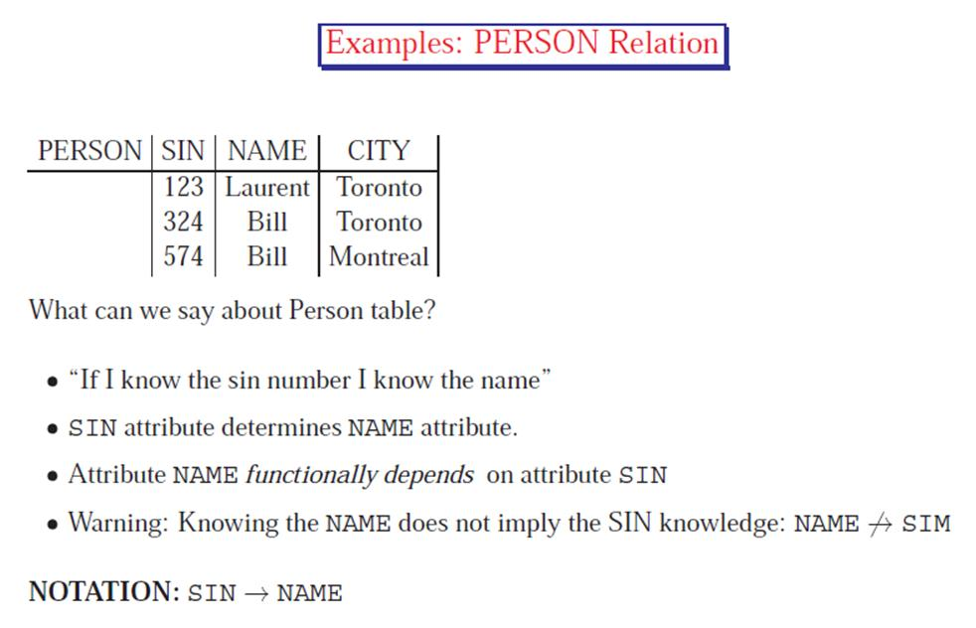
Reference: University of Toronto, Database Group, http://www.cs.toronto.edu/db/courses/343/Summer2003_L5201/FD.pdf
Slide 10- <number>

Slide 21
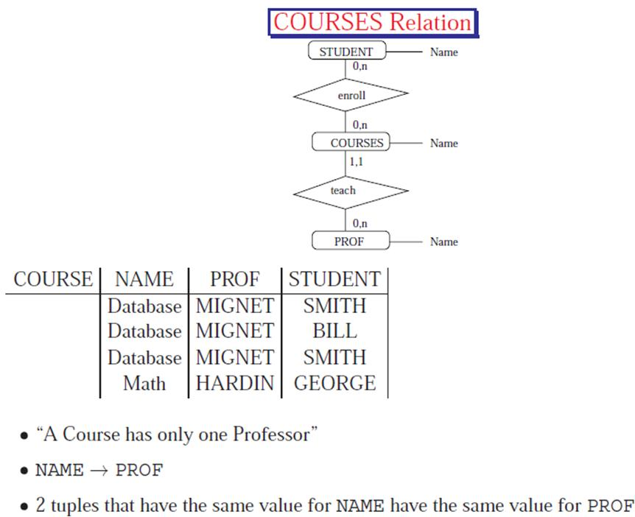
Reference: University of Toronto, Database Group, http://www.cs.toronto.edu/db/courses/343/Summer2003_L5201/FD.pdf
Slide 10- <number>

Slide 22
Functional Dependencies (2)
X -> Y holds if whenever two tuples have the same value for X, they must have the same value for Y
  For any two tuples t1 and t2 in any relation instance r(R):
  If t1[X]=t2[X], then t1[Y]=t2[Y]
X -> Y in R specifies a constraint on all relation instances r(R)
FDs are derived from the real-world constraints on the attributes
Written as X -> Y; can be displayed graphically on a relation (see next)
Slide 10- <number>

Slide 23
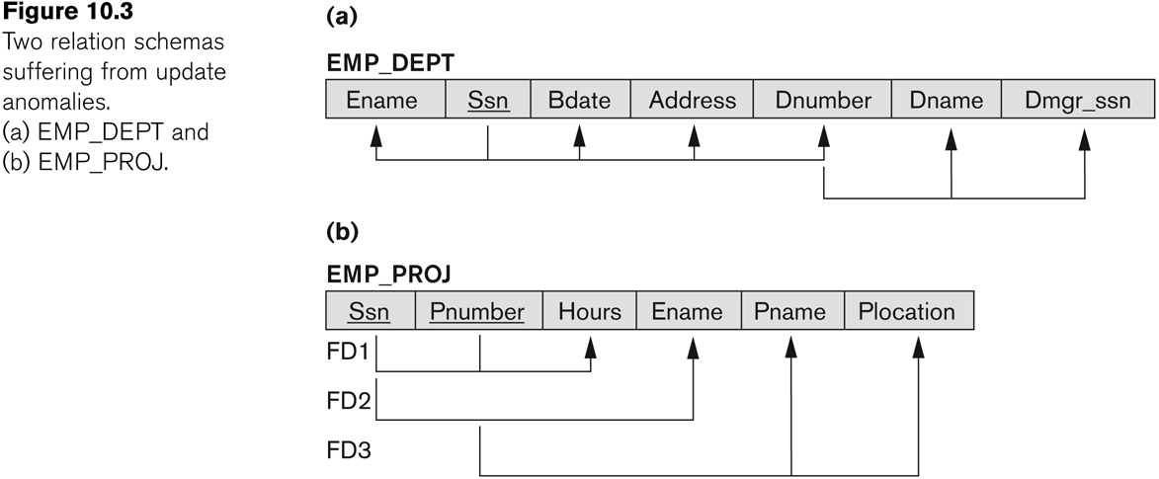
FDs on two schemas
Slide 10- <number>
Notes:
A functional dependency occurs when one attribute in a relation uniquely determines another attribute.

Slide 24
Examples of FD constraints (1)
FDs are derived from the real-world constraints on the attributes
Social security number determines employee name
  SSN -> ENAME
  SSN is the determinant
Project number determines project name and location
  PNUMBER -> {PNAME, PLOCATION}
Employee ssn and project number determines the hours per week that the employee works on the project
  {SSN, PNUMBER} -> HOURS
Slide 10- <number>

Slide 25
Examples of FD constraints (2)
An FD is a property of the attributes in the schema R
The constraint must hold on every relation instance r(R)
If K is a key of R, then K functionally determines all attributes in R
  since we never have two distinct tuples with t1[K]=t2[K]
Slide 10- <number>

Slide 26

2.2 Inference Rules for FDs (1)
Given a set of FDs F, we can infer additional FDs that hold whenever the FDs in F hold
Armstrong's inference rules:
  IR1. (Reflexive) If Y ⊆ X, then X -> Y
    Example: NAME CITY -> NAME
    Trivial: “Two persons who have the same name and live in the same city have the same name.”
    A B -> A
Slide 10- <number>
Notes:
By sound, we mean that given a set of functional dependencies F specified on a relation schema R, any dependency that we can infer from F by using IR1 through IR3 holds in every relation state r of R that satisfies the dependencies in F. By complete, we mean
1.Tuple duzeyinde (tum relationlarda) tum IR lar saglanacak
2. Olabilecek tum kurallar cikacak

Slide 27
2.2 Inference Rules for FDs (1)
Given a set of FDs F, we can infer additional FDs that hold whenever the FDs in F hold
Armstrong's inference rules:
  IR2. (Augmentation) If X -> Y, then XZ -> YZ
    (Notation: XZ stands for X U Z)
    Example:
    SIN -> ZIPCODE |= SIN CITY -> ZIPCODE CITY
    If A -> B then A C -> B C
Slide 10- <number>

Slide 28
2.2 Inference Rules for FDs (1)
Given a set of FDs F, we can infer additional FDs that hold whenever the FDs in F hold
Armstrong's inference rules:
  IR3. (Transitive) If X -> Y and Y -> Z, then X -> Z
  Example:
  R(SIN, ZIPCODE, CITY)
  {SIN -> ZIPCODE, ZIPCODE -> CITY } |= SIN -> CITY
  “If we know the zipcode from a sin number and the city from the zipcode then we know the city from the sin number.”
Slide 10- <number>
Notes:
By sound, we mean that given a set of functional dependencies F specified on a relation schema R, any dependency that we can infer from F by using IR1 through IR3 holds in every relation state r of R that satisfies the dependencies in F. By complete, we mean
1.Tuple duzeyinde (tum relationlarda) tum IR lar saglanacak
2. Olabilecek tum kurallar cikacak

Slide 29
2.2 Inference Rules for FDs (1)
IR1, IR2, IR3 form a sound and complete set of inference rules
  These are rules hold and all other rules that hold can be deduced from these
  IR1. (Reflexive) If Y subset-of X, then X -> Y
  IR2. (Augmentation) If X -> Y, then XZ -> YZ
  IR3. (Transitive) If X -> Y and Y -> Z, then X -> Z
Slide 10- <number>
Notes:
By sound, we mean that given a set of functional dependencies F specified on a relation schema R, any dependency that we can infer from F by using IR1 through IR3 holds in every relation state r of R that satisfies the dependencies in F. By complete, we mean
1.Tuple duzeyinde (tum relationlarda) tum IR lar saglanacak
2. Olabilecek tum kurallar cikacak

Slide 30
Inference Rules for FDs (2)
Some additional inference rules that are useful:
  Decomposition:
  If X -> YZ, then X -> Y and X -> Z
  Union:
  If X -> Y and X -> Z, then X -> YZ
  Pseudotransitivity:
  If X -> Y and WY -> Z, then WX -> Z
These inference rules can be deduced from IR1, IR2, and IR3 (completeness property)
Slide 10- <number>

Slide 31
Caution!
Given ABC -> ADE we CANNOT conclude BC->DE
You cannot drop A from the both sides.
Use ONLY the rules given.
Slide 10- <number>

Slide 32
Inference Rules for FDs (3)
Closure of a set F of FDs is the set F⁺ of all FDs that can be inferred from F
Closure of a set of attributes X with respect to F is the set X⁺ of all attributes that are functionally determined by X
X⁺ can be calculated by repeatedly applying IR1, IR2, IR3 using the FDs in F
Slide 10- <number>
Notes:
{S#, P#} → {CITY, QTY} implies
both {S#, P#} → CITY and {S#, P#} → QTY

Slide 33
Closure of an attribute X⁺ w.r.t FD set F
Closure= {X}
Repeat until closure does not change{
if there is P -> R in F such that P ⊆ Closure
then Closure=Closure U R
}
Return Closure
Slide 10- <number>

Slide 34
FD Closure Example
Given R= ABCD and F= {A →B, A →C, CD→A}. Compute F⁺.
Solution:
A⁺_{F}= {ABC}
B⁺_{F}= {B}
…
AB⁺_{F}= {ABC}
AC⁺_{F}= {ABC}
…
ABC⁺_{F}= …
Reference: University of Toronto, Database Group, http://www.cs.toronto.edu/db/courses/343/Summer2003_L5201/FD.pdf
Slide 10- <number>

Slide 35
FD Closure Example
Given R= ABCDEGH and
F= {A →DE, C →ADH, BH→GE, ABH →C, BGH →C}.
Compute X⁺_{F} for sets of attributes X such that X appears on the left hand side of a FD in F.
Solution:
A⁺_{F}= {ADE}
C⁺_{F}= {ACDEH}
BH⁺_{F}= {ABCDEGH}
ABH⁺_{F}= {ABCDEGH}
BGH⁺_{F}= {ABCDEGH}
Reference: University of Toronto, Database Group, http://www.cs.toronto.edu/db/courses/343/Summer2003_L5201/FD.pdf
Slide 10- <number>

Slide 36
2.3 Equivalence of Sets of FDs
Two sets of FDs F and G are equivalent if:
  Every FD in F can be inferred from G, and
  Every FD in G can be inferred from F
  Hence, F and G are equivalent if F⁺ =G⁺
Definition (Covers):
  F covers G if every FD in G can be inferred from F
    (i.e., if G⁺ subset-of F⁺)
F and G are equivalent if F covers G and G covers F
Slide 10- <number>

Slide 37
2.4 Minimal Sets of FDs (1)
A set of FDs is minimal if it satisfies the following conditions:
  Every dependency in F has a single attribute for its RHS.
  We cannot remove any dependency from F and have a set of dependencies that is equivalent to F.
  We cannot replace any dependency X -> A in F with a dependency Y -> A, where Y ⊂ X and still have a set of dependencies that is equivalent to F.
Slide 10- <number>

Slide 38
Minimal Sets of FDs (2)
Every set of FDs has an equivalent minimal set
There can be several equivalent minimal sets
There is no simple algorithm for computing a minimal set of FDs that is equivalent to a set F of FDs
3 steps --- IN THIS ORDER
  Put each FD in canonical form, i.e. there is only 1 attribute on the rhs , e.g. A->CB into A->C, A->B
  Remove redundant attributes in the dependencies
  Remove redundant dependencies
Slide 10- <number>

Slide 39
Computing the Minimal Sets of FDs
Given the set of FD is E : {B → A, D → A, AB → D}.
Find the minimum cover of E.
step1: All the dependencies are in canonical form. (nothing to do here)
Step2: remove redundant attributes in dependencies
We need to determine if AB → D has any redundant attribute on the left-hand side;
i.e. can it be replaced by B → D or A → D?
Slide 10- <number>

Slide 40
Checking if an attribute is redundant
Let X and Y be sets of attributes,
Let B be a single attribute
Given a FD set F such that (XB -> Y ) ∈ F
B is redundant if
F ⇒ (X->Y)
i.e. if Y ⊆ X⁺ under F
Actually we check if F ⇒ (F \ {XB->Y}) U {X->Y}
If so, we can replace F with (F \ {XB->Y}) U {X->Y}
Slide 10- <number>

Slide 41
Computing the Minimal Sets of FDs
Given the set of FD is E : {B → A, D → A, AB → D}.
Can we replace AB → D with B → D or A → D?
■ B → A ; given
BB → AB ; augmenting with B on both sides (IR2)
B → AB (i); BB is equal to B
AB → D ; given (ii)
B → D; transitive rule (IR3) using (i) and (ii)
■ AB → D may be replaced by B → D
Since we showed that E ⇒ (E \ {AB->D}) U {B->D}
By showing E ⇒ (B->D)
■ Now we have E′ : {B → A, D → A, B → D} replacing E
No further reduction is possible: all FDs have a single attribute on the left-hand side.
Slide 10- <number>
Notes:
Alternatively, show that D is-element-of B+underF
B+={A, D}
Why?
Since B->A , A is-element-of B
Since AB->D, D is-element-of B …..we can use AB->D since we said B+ under F

Slide 42
Computing the Minimal Sets of FDs
Given the set of FD is E : {B → A, D → A, AB → D}.
Step1: canonical form
Step2: remove redundant attributes
E′ : {B → A, D → A, B → D}.
Step 3: remove redundant FD in E′.
By using the transitive rule on B → D and D → A, we derive B → A.
Therefore, B → A is redundant in E’ and can be eliminated.
Finally: the minimum cover of E is {B → D, D → A}.
Slide 10- <number>

Slide 43
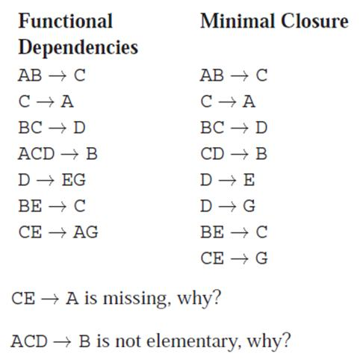
Example:
Reference: University of Toronto, Database Group, http://www.cs.toronto.edu/db/courses/343/Summer2003_L5201/FD.pdf
Slide 10- <number>

Slide 44
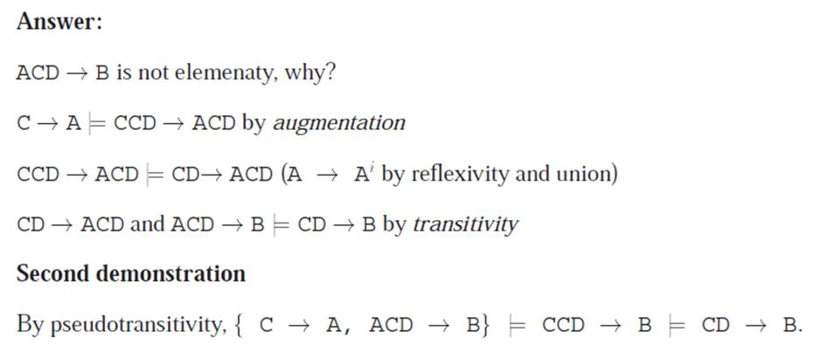
Answer:
Reference: University of Toronto, Database Group, http://www.cs.toronto.edu/db/courses/343/Summer2003_L5201/FD.pdf
Slide 10- <number>

Slide 45
Definitions of Keys and Attributes Participating in Keys (1)
A superkey of a relation schema R = {A1, A2, ...., An} is a set of attributes S ⊆ R with the property that no two tuples t1 and t2 in any legal relation state r of R will have t1[S] = t2[S]
A key K is a superkey with the additional property that removal of any attribute from K will cause K not to be a superkey any more.
Slide 10- <number>

Slide 46
Definitions of Keys and Attributes Participating in Keys (2)
If a relation schema has more than one key, each is called a candidate key.
  One of the candidate keys is arbitrarily designated to be the primary key, and the others are called secondary keys.
A Prime attribute must be a member of some candidate key
A Nonprime attribute is not a prime attribute—that is, it is not a member of any candidate key.
Slide 10- <number>

Slide 47
Example:
Consider a relation R with attributes
R-> {A,B,C,D,E,H,G} and the FD set
F={A→CH, H→G, EG→B, B→C, C→D, AG→E}.
List all the keys of R.
Find the minimal subset of R.
Slide 10- <number>
Notes:
keys=A
A->C, A->H, C->D, H->G, B->C, EG->B, A->E (why? Below)
AG->E is redundant since F implies {A->E} u (F \ {AG->E} , i.e. F implies {A->E}
Or E is-element-of A+ under F. it is true since A+={C,H,D,G,E,B} under F
Implication proof: A->H and H->G then A->G.
AG->E and A->G then AA->E which is A->E

Slide 48
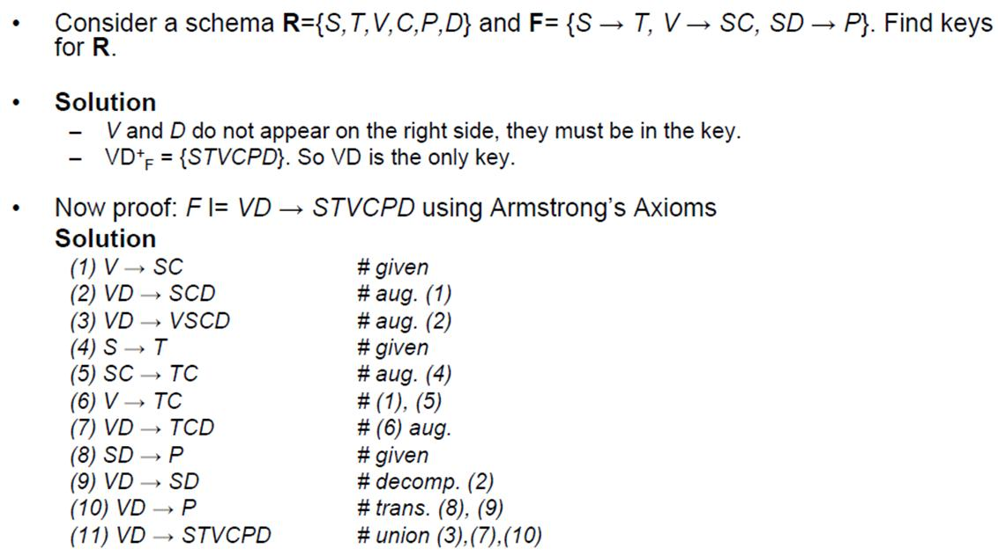
Reference: University of Toronto, Database Group, http://www.cs.toronto.edu/~leijiang/teaching/cscc43-s09/content/tutorial/fd/fd.pdf
Slide 10- <number>

Slide 49
3 Normal Forms Based on Primary Keys
3.1 Normalization of Relations
3.2 Practical Use of Normal Forms
3.3 Definitions of Keys and Attributes Participating in Keys
3.4 First Normal Form
3.5 Second Normal Form
3.6 Third Normal Form
Slide 10- <number>

Slide 50
3.1 Normalization of Relations (1)
Normalization:
  The process of decomposing unsatisfactory "bad" relations by breaking up their attributes into smaller relations
Normal form:
  Condition using keys and FDs of a relation to certify whether a relation schema is in a particular normal form
Slide 10- <number>

Slide 51
Normalization of Relations (2)
2NF, 3NF, BCNF
  based on keys and FDs of a relation schema
Additional properties may be needed to ensure a good relational design
  lossless join, dependency preservation (next lecture)
Slide 10- <number>

Slide 52
3.2 Practical Use of Normal Forms
Normalization is carried out in practice so that the resulting designs are of high quality and meet the desirable properties
The practical utility of these normal forms becomes questionable when the constraints on which they are based are hard to understand or to detect
The database designers need not normalize to the highest possible normal form
  (usually up to 3NF, BCNF or 4NF)
Denormalization:
  The process of storing the join of higher normal form relations as a base relation—which is in a lower normal form
Slide 10- <number>

Slide 53
3.2 First Normal Form
Disallows
  composite attributes
  multivalued attributes
  nested relations; attributes whose values for an individual tuple are non-atomic
NF1 is considered to be part of the definition of relation
Slide 10- <number>

Slide 54

Multivalued attribute
Slide 10- <number>
Notes:
Dlocation multi valued idi, simdi degil

Slide 55
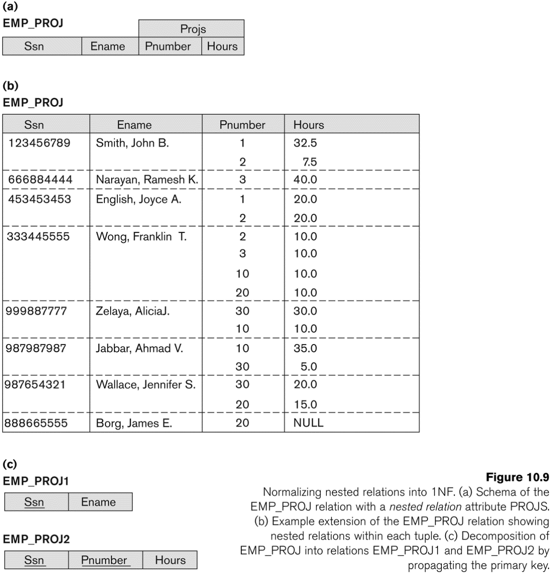
Nested relation
Nested relation
Slide 10- <number>

Slide 56
3.3 Second Normal Form (1)
Uses the concepts of FDs, primary key
Definitions
  Prime attribute: An attribute that is member of the primary key K
  Full functional dependency: a FD Y -> Z where removal of any attribute from Y means the FD does not hold any more
Examples:
  {SSN, PNUMBER} -> HOURS is a full FD since
  neither SSN -> HOURS nor PNUMBER -> HOURS hold
  {SSN, PNUMBER} -> ENAME is not a full FD (it is called a partial dependency ) since SSN -> ENAME also holds
Slide 10- <number>
Notes:
Emp_proj tablosuna bakarak examples kismina bak.

Slide 57
Second Normal Form (2)
A relation schema R is in second normal form (2NF) if every non-prime attribute A in R is fully functionally dependent on the primary key
  i.e. All attributes depend on the whole key
Slide 10- <number>

Slide 58
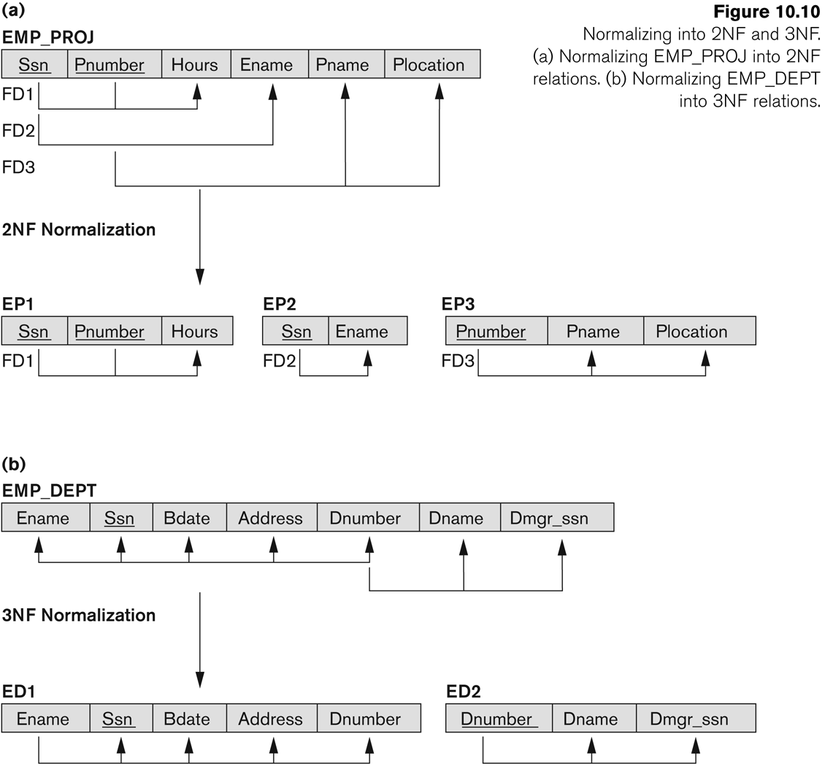
Normalizing into 2NF and 3NF
Ename is not fully dependent on (Ssn,Pnumber)
Pname and Plocation are not fully dependent on the key
Normalizing into 2NF
Slide 10- <number>

Slide 59
R can be decomposed into 2NF relations via the process of 2NF normalization
Decompose and set up a new relation for each partial key with its dependent attributes
  E.g. EP2 and EP3 in the previous slide
Make sure to keep a relation with the original primary key and any attributes that are fully functionally dependent on it
  E.g. EP1 in the previous slide
Slide 10- <number>

Slide 60
3.4 Third Normal Form (1)
Definition:
  Transitive functional dependency: a FD X -> Z that can be derived from two FDs
  X -> Y and Y -> Z
Examples:
  SSN -> DMGRSSN is a transitive FD
    Since SSN -> DNUMBER and DNUMBER -> DMGRSSN hold
  SSN -> ENAME is non-transitive
    Since there is no set of attributes X where SSN -> X and X -> ENAME
Slide 10- <number>

Slide 61
Third Normal Form (2)
A relation schema R is in third normal form (3NF) if it is in 2NF and no non-prime attribute A in R is transitively dependent on the primary key
NOTE:
  In X -> Y and Y -> Z, with X as the primary key, we consider this as a problem only if Y is not a candidate key.
  When Y is a candidate key, there is no problem with the transitive dependency .
  E.g., Consider EMP (SSN, Emp#, Salary ).
    Here, SSN -> Emp# -> Salary and Emp# is a candidate key.
Slide 10- <number>

Slide 62
Normalizing into 2NF and 3NF
Dname and Dmgr_ssn
depend on sth other than the key
Slide 10- <number>
Notes:
The dependency SSN->DMGRSSN is transitive through DNUMBER in EMP_DEPT of the Figure because both the dependencies SSN->DNUMBER and DNUMBER->DMGRSSN hold and DNUMBER is neither a key itself nor a subset of the key of EMP_DEPT. Intuitively, we can see that the dependency of DMGRSSN on DNUMBER is undesirable in EMP_DEPT since DNUMBER is not a key of EMP_DEPT.

Slide 63
R can be decomposed into 3NF relations via the process of 3NF normalization
Decompose and set up a relation that includes the non-key attributes that functionally determine other non-key attributes
Find the minimal set of FDs
For each X -> A₁A₂A₃…A_{n} create a table where X is the key and includes A₁..A_{n}
Place the left over attributes in one of the relations.
Slide 10- <number>

Slide 64
Normal Forms Defined Informally
1st normal form
  All attributes depend on the key
2nd normal form
  All attributes depend on the whole key
3rd normal form
  All attributes depend on nothing but the key
Slide 10- <number>

Slide 65
Find the minimal FD set before any normalization!
Otherwise, too many FDs will require too many decompositions, some of which are unnecessary
Slide 10- <number>

Slide 66
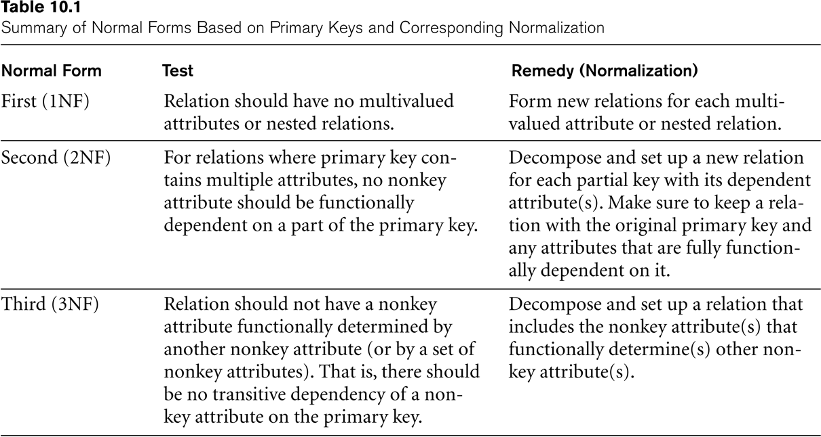
SUMMARY OF NORMAL FORMS based on Primary Keys
Slide 10- <number>

Slide 67
General Normal Form Definitions
(For Multiple Keys) (1)
The above definitions consider the primary key only
The following more general definitions take into account relations with multiple candidate keys
A relation schema R is in second normal form (2NF) if every non-prime attribute A in R is fully functionally dependent on every key of R
Slide 10- <number>

Slide 68
Example: LOTS
LOTS table describes parcels of land for sale in various countries of a state.
  Attributes: property_id#, county_name, lot#, area, price, tax_rate
Lot numbers are unique only within each country, but PROPERTY_ID numbers are unique across counties for the entire state.
  there are two candidate keys: PROPERTY_ID# and {COUNTY_NAME,LOT#};
The tax rate is fixed for a given country (does not vary lot by lot within the same country),
  FD3: COUNTY_NAME->TAX_RATE
the price of a lot is determined by its area regardless of which country it is in. (Assume that this is the price of the lot for tax purposes)
  FD4: AREA->PRICE
Slide 10- <number>

Slide 69
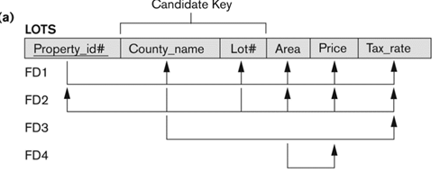
Example (1): the schema
The LOTS relation schema violates the general definition of 2NF because TAX_RATE is partially dependent on the candidate key {COUNTRY_NAME, LOT#}, due to FD3
.
In 2NF, all non-prime attributes should be wholly dependent on the prime attributes that are our primary key and candidate keys separately.
Slide 10- <number>

Slide 70
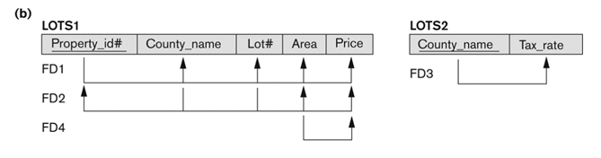
Example (2): normalizing to 2NF
We construct LOTS1 by removing the attribute TAX_RATE that violates 2NF from LOTS and placing it with COUNTRY_NAME into another relation LOTS2. Both LOTS1 and LOTS2 are in 2NF.
FD4 does not violate 2NF since price is still dependent to whole key
Slide 10- <number>

Slide 71
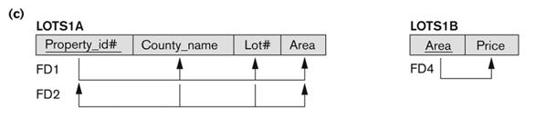
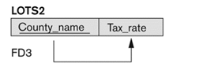
Example (3): normalizing to 3NF
Fd4 is transitivity. Decompose it to its own table.
Slide 10- <number>

Slide 72
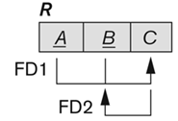
General Normal Form Definitions (2)
Definition:
  Superkey of relation schema R - a set of attributes S of R that contains a key of R
  A relation schema R is in third normal form (3NF) if whenever a FD X -> A holds in R, then either:
    (a) X is a superkey of R, or
    (b) A is a prime attribute of R
NOTE: Boyce-Codd normal form disallows the condition (b)
  it does not allow a non-prime attribute determining a prime attribute
Slide 10- <number>

Slide 73
5 BCNF (Boyce-Codd Normal Form)
A relation schema R is in Boyce-Codd Normal Form (BCNF) if whenever an FD X -> A holds in R, then X is a superkey of R
  A BCNF relation is a 3NF relation with no dependency of prime attributes on nonprime attributes
Each normal form is strictly stronger than the previous one
  Every 2NF relation is in 1NF
  Every 3NF relation is in 2NF
  Every BCNF relation is in 3NF
There exist relations that are in 3NF but not in BCNF
The goal is to have each relation in BCNF (or 3NF)
Slide 10- <number>

Slide 74
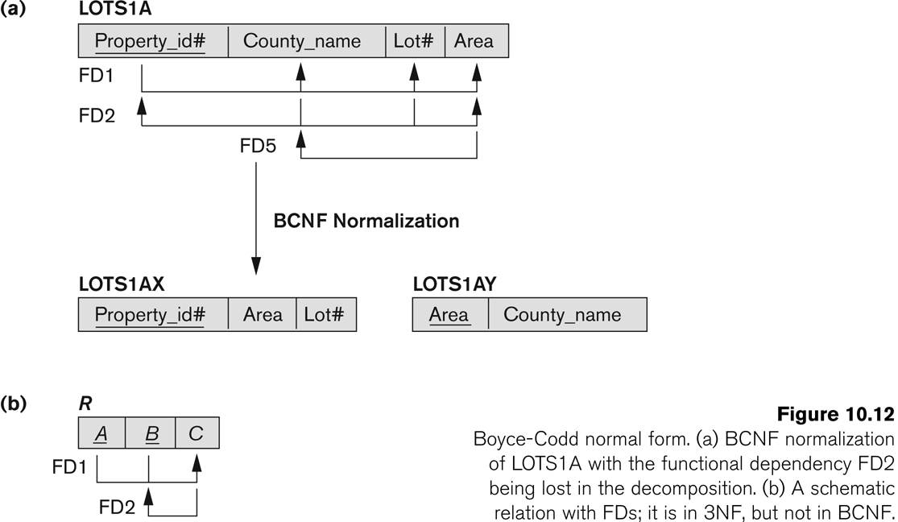
Boyce-Codd Normal Form
Decomposition based on the attribute of the FD which violates the BCNF condition (FD5)
Slide 10- <number>

Slide 75
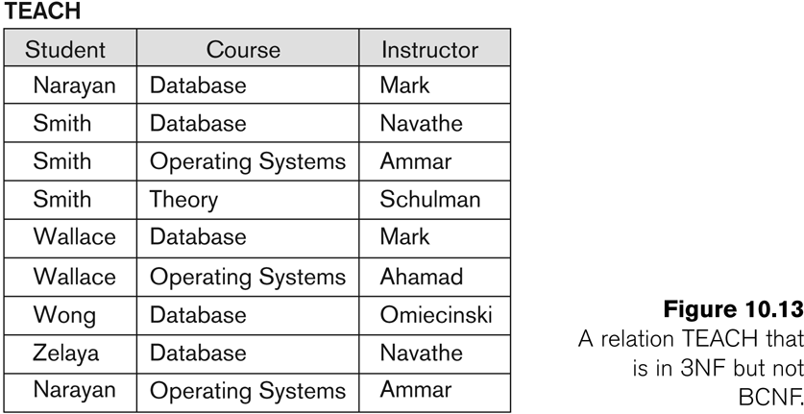
A relation TEACH that is in 3NF but not in BCNF
fd1: { student, course} -> instructor
fd2: instructor -> course
Slide 10- <number>
Notes:
Since instructor determines the course

Slide 76
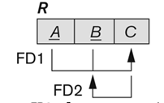
Achieving the BCNF by Decomposition (1)
Two FDs exist in the relation TEACH:
  fd1: { student, course} -> instructor
  fd2: instructor -> course
{student, course} is a candidate key for this relation and that the dependencies shown follow the pattern
  So this relation is in 3NF but not in BCNF
A relation NOT in BCNF should be decomposed so as to meet this property, while possibly forgoing the preservation of all functional dependencies in the decomposed relations.
Slide 10- <number>

Slide 77
Achieving the BCNF by Decomposition (2)
Three possible decompositions for relation TEACH
  {student, instructor} and {student, course}
  {course, instructor } and {course, student} generates
  spurious tuples
  {instructor, course } and {instructor, student} desired one
All three decompositions will lose fd1.
  We have to settle for sacrificing the functional dependency preservation. But we cannot sacrifice the non-additivity property after decomposition.
Slide 10- <number>

Slide 78
Achieving the BCNF by Decomposition (2)
Three possible decompositions for relation TEACH
  {student, instructor} and {student, course}
Student | Instructor | Course
Narayan | Mark | Database
Narayan | Mark | Operating Systems
Smith | Navathe | Database
Smith | Navathe | Operating Systems
Smith | Navathe | Theory
Smith | Ammar | Database
Smith | Ammar | Operating Systems
Smith | Ammar | Theory
Smith | Schulman | Database
Smith | Schulman | Operating Systems
Smith | Schulman | Theory
Wallace | Mark | Database
Wallace | Mark | Operating Systems
Wallace | Ahamad | Database
Wallace | Ahamad | Operating Systems
Wong | Omiecinski | Database
Zelaya | Navathe | Database
Narayan | Ammar | Operating Systems
Student | Instructor
Narayan | Mark
Smith | Navathe
Smith | Ammar
Smith | Schulman
Wallace | Mark
Wallace | Ahamad
Wong | Omiecinski
Zelaya | Navathe
Narayan | Ammar
Student | Course
Narayan | Database
Smith | Database
Smith | Operating Systems
Smith | Theory
Wallace | Database
Wallace | Operating Systems
Wong | Database
Zelaya | Database
Narayan | Operating Systems
Join
Spurious tuples are marked as red.
They are not in the original table.
Slide 10- <number>

Slide 79
Achieving the BCNF by Decomposition (2)
Three possible decompositions for relation TEACH
  {student, instructor} and {student, course}
  {course, instructor } and {course, student} generates spurious tuples
  the same course is given by different instructors. A student will appear as registered to all the courses that have same name but are given by different instructors.
  {instructor, course } and {instructor, student} desired one
Slide 10- <number>

Slide 80
Achieving the BCNF by Decomposition (2)
Three possible decompositions for relation TEACH
  {student, instructor} and {student, course}
  {course, instructor } and {course, student} generates
  spurious tuples
  {instructor, course } and {instructor, student} desired one
Only {instructor, course } and {instructor, student} decomposition will not generate spurious tuples after join.
A test to determine whether a binary decomposition (decomposition into two relations) is non-additive (lossless) is in the next lecture.
  Lossless join test for binary decomposition (quick peek)
  Let R1 and R2 be decomposition of R with FD set F.
  Decomposition is lossless If at least one of these FDs are in F+
    (R1 ∩ R2 ) -> R1 –R2
    (R1 ∩ R2 ) -> R2 - R1
Slide 10- <number>

Slide 81
Chapter Summary
Informal Design Guidelines for Relational Databases
Functional Dependencies (FDs)
  Definition, Inference Rules, Equivalence of Sets of FDs, Minimal Sets of FDs
Normal Forms Based on Primary Keys
General Normal Form Definitions (For Multiple Keys)
BCNF (Boyce-Codd Normal Form)
Slide 10- <number>

Slide 82
Exercise1
Table shows a shipping manifest.
a. Draw a relational schema and diagram to show the functional dependencies in the relation.
b. In what normal form is this relation?
c. Decompose MANIFEST into a set of 3NF relations.
d. Draw a relational schema for your 3NF relations and show the referential integrity constraints.
Shipping Manifest
Shipment ID: 00-0001
Origin: Boston
Destination: Brazil
Ship number: 39
Shipping Date: 01/10/2006
Expected Arrival: 01/14/2006
Captain: 002-15
Name: Henry Moore
Item Number | Type. | Description | Weight | Quantity | T. Weight
3223 | BM | Concrete Form | 500 | 100 | 50000
3297 | BM | Steel Beam | 87 | 2000 | 174000
Shipment Total: 224000

Slide 83
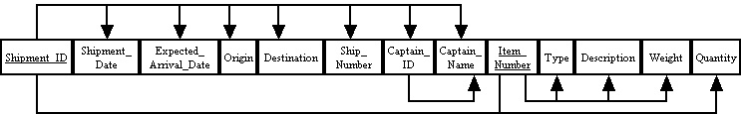
Example 1
a.
Shipping Manifest
Shipment ID: 00-0001
Origin: Boston
Destination: Brazil
Ship number: 39
Shipping Date: 01/10/2006
Expected Arrival: 01/14/2006
Captain: 002-15
Name: Henry Moore
Item Number | Type. | Description | Weight | Quantity | T. Weight
3223 | BM | Concrete Form | 500 | 100 | 50000
3297 | BM | Steel Beam | 87 | 2000 | 174000
Shipment Total: 224000

Slide 84
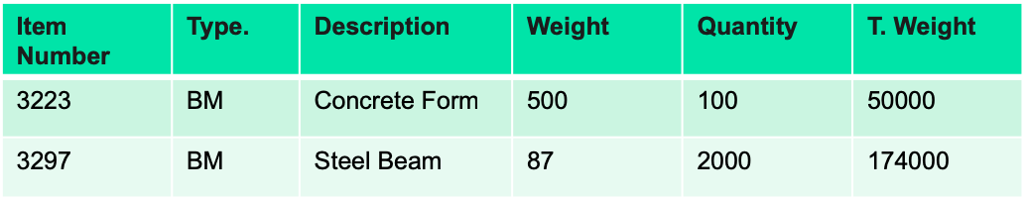
Example 1
b. In what normal form is this relation?
Not first normal form
Shipping Manifest
Shipment ID: 00-0001
Origin: Boston
Destination: Brazil
Ship number: 39
Shipping Date: 01/10/2006
Expected Arrival: 01/14/2006
Captain: 002-15
Henry Moore
This is first normal form
Shipment Total: 224000

Slide 85
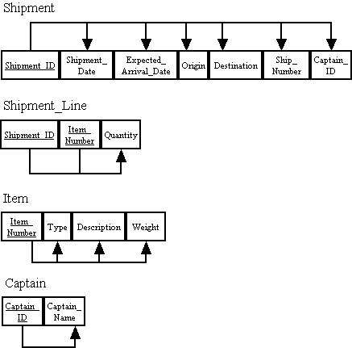
Example 1
c. Decompose MANIFEST into a set of 3NF relations.
Shipping Manifest
Shipment ID: 00-0001
Origin: Boston
Destination: Brazil
Ship number: 39
Shipping Date: 01/10/2006
Expected Arrival: 01/14/2006
Captain: 002-15
Henry Moore
Item Number | Type Descr. | Weight | Weight | Quantity | T. Weight
3223 | BM | Concrete Form | 500 | 100 | 50000
3297 | BM | Steel Beam | 87 | 2000 | 174000
Shipment Total: 224000

Slide 86
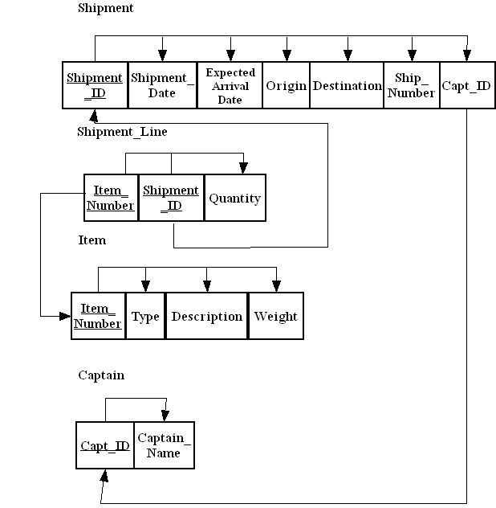
Example 1
c. Draw a relational schema for your 3NF relations and show the referential integrity constraints.
Shipping Manifest
Shipment ID: 00-0001
Origin: Boston
Destination: Brazil
Ship number: 39
Shipping Date: 01/10/2006
Expected Arrival: 01/14/2006
Captain: 002-15
Henry Moore
Item Number | Type Descr. | Weight | Weight | Quantity | T.Weight
3223 | BM | Concrete Form | 500 | 100 | 50000
3297 | BM | Steel Beam | 87 | 2000 | 174000
Shipment Total: 224000

Slide 87
Exercise 2
The Public Safety office at Millennium College maintains a list of parking tickets issued to vehicles parked illegally on the campus.
  Convert this table to a relation in first normal form by entering appropriate data in the table. What are the determinants in this relation?
  Draw a dependency diagram showing all functional dependencies in the relation, based on the sample data shown.
  Give an example of one or ore anomalies that can result in using this relation.
  Develop a set of relations in third normal form. Include a new column with the heading Violation in the appropriate table to explain the reason for each ticket. Values in this column are: expired parking meter (ticket code 1), no parking permit (ticket code 2) and handicap violation (ticket code 3).
St_ID | L_Name | F_Name | Phone_No | St_Lic | Lic_No | Ticket# | Date | Code | Fine
38249 | Brown | Thomas | 111-7804 | FL | BRY 123 | 15634 | 10/17/06 | 2 | $25
 |  |  |  |  |  | 16017 | 11/13/06 | 1 | $15
82453 | Green | Sally | 391-1689 | AL | TRE 141 | 14987 | 10/05/06 | 3 | $100
 |  |  |  |  |  | 16293 | 11/18/06 | 1 | $15
 |  |  |  |  |  | 17892 | 12/13/06 | 2 | $25

Slide 88
Example 2
Convert this table to a relation in first normal form by entering appropriate data in the table. What are the determinants in this relation?
St_ID | L_Name | F_Name | Phone_No | St_ Lic | Lic_No | Ticket# | Date | Code | Fine
38249 | Brown | Thomas | 111-7804 | FL | BRY 123 | 15634 | 10/17/08 | 2 | $25
38249 | Brown | Thomas | 111-7804 | FL | BRY 123 | 16017 | 11/13/08 | 1 | $15
82453 | Green | Sally | 391-1689 | AL | TRE 141 | 14987 | 10/05/08 | 3 | $100
82453 | Green | Sally | 391-1689 | AL | TRE 141 | 16293 | 11/18/08 | 1 | $15
82453 | Green | Sally | 391-1689 | AL | TRE-141 | 17892 | 12/13/08 | 2 | $25
The determinants are: ST_ID, Ticket#, Code.
St_ID | L_Name | F_Name | Phone_No | St_Lic | Lic_No | Ticket# | Date | Code | Fine
38249 | Brown | Thomas | 111-7804 | FL | BRY 123 | 15634 | 10/17/06 | 2 | $25
 |  |  |  |  |  | 16017 | 11/13/06 | 1 | $15
82453 | Green | Sally | 391-1689 | AL | TRE 141 | 14987 | 10/05/06 | 3 | $100
 |  |  |  |  |  | 16293 | 11/18/06 | 1 | $15
 |  |  |  |  |  | 17892 | 12/13/06 | 2 | $25

Slide 89
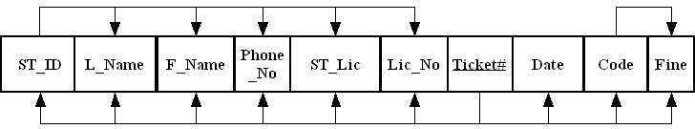
Example 2
Draw a dependency diagram showing all functional dependencies in the relation, based on the sample data shown.
St_ID | L_Name | F_Name | Phone_No | St_Lic | Lic_No | Ticket# | Date | Code | Fine
38249 | Brown | Thomas | 111-7804 | FL | BRY 123 | 15634 | 10/17/06 | 2 | $25
 |  |  |  |  |  | 16017 | 11/13/06 | 1 | $15
82453 | Green | Sally | 391-1689 | AL | TRE 141 | 14987 | 10/05/06 | 3 | $100
 |  |  |  |  |  | 16293 | 11/18/06 | 1 | $15
 |  |  |  |  |  | 17892 | 12/13/06 | 2 | $25

Slide 90
Example 2
Give an example of one or ore anomalies that can result in using this relation.
An insertion anomaly occurs when you try to insert a student who has never had a parking ticket.
A deletion anomaly would occur if you were to delete a record of any student with only one parking ticket since all student information will be lost.
A modification anomaly would occur whenever you want to update the Phone_No (or name, State License, or License Number) data of a student.
St_ID | L_Name | F_Name | Phone_No | St_Lic | Lic_No | Ticket# | Date | Code | Fine
38249 | Brown | Thomas | 111-7804 | FL | BRY 123 | 15634 | 10/17/06 | 2 | $25
 |  |  |  |  |  | 16017 | 11/13/06 | 1 | $15
82453 | Green | Sally | 391-1689 | AL | TRE 141 | 14987 | 10/05/06 | 3 | $100
 |  |  |  |  |  | 16293 | 11/18/06 | 1 | $15
 |  |  |  |  |  | 17892 | 12/13/06 | 2 | $25

Slide 91
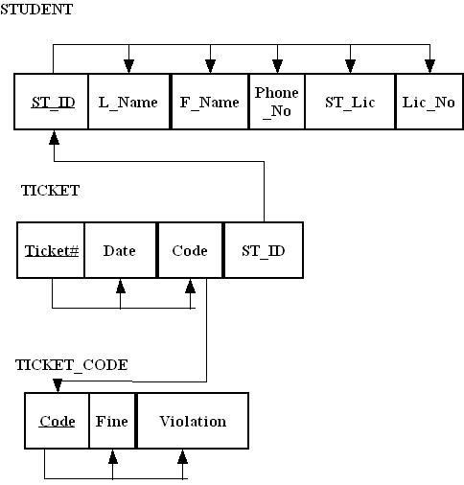
Example 2
Develop a set of relations in third normal form. Include a new column with the heading Violation in the appropriate table to explain the reason for each ticket. Values in this column are: expired parking meter (ticket code 1), no parking permit (ticket code 2) and handicap violation (ticket code 3).
St_ID | L_Name | F_Name | Phone_No | St_Lic | Lic_No | Ticket# | Date | Code | Fine
38249 | Brown | Thomas | 111-7804 | FL | BRY 123 | 15634 | 10/17/06 | 2 | $25
 |  |  |  |  |  | 16017 | 11/13/06 | 1 | $15
82453 | Green | Sally | 391-1689 | AL | TRE 141 | 14987 | 10/05/06 | 3 | $100
 |  |  |  |  |  | 16293 | 11/18/06 | 1 | $15
 |  |  |  |  |  | 17892 | 12/13/06 | 2 | $25

